Slide 2
ABOUT US?
Company Name: Savatarr Technologies Private Limited
Established: 2020
Location: Headquarters in Noida Sector 62.
Industry: Digital Marketing, Software Development and Software as a Service (SaaS) Provider
Mission: To revolutionize the tech industry by delivering cutting-edge solutions that empower businesses and individuals to thrive in the digital age.

Slide 3
KEY OFFERINGS:
WEB APPS
BRAND MARKETING
Innovative web-based applications tailored to streamline business processes and enhance user experience.
Strategic digital marketing services aimed at maximizing online visibility, engagement, and conversion for businesses of all sizes.
SaaS PRODUCTS
MOBILE APPS
Cutting-edge mobile applications designed to engage users and drive business growth on iOS and Android platforms.
Scalable and customizable Software as a Service solutions designed to optimize business operations and accelerate growth.
RESEARCH & DEV.
CYBER SECURITY
Pioneering research and development initiatives focused on driving technological innovation and staying ahead of market trends.
Comprehensive solutions and strategies aimed at safeguarding digital assets, protecting against cyber threats, and ensuring data integrity and confidentiality in an increasingly interconnected world.

Slide 4
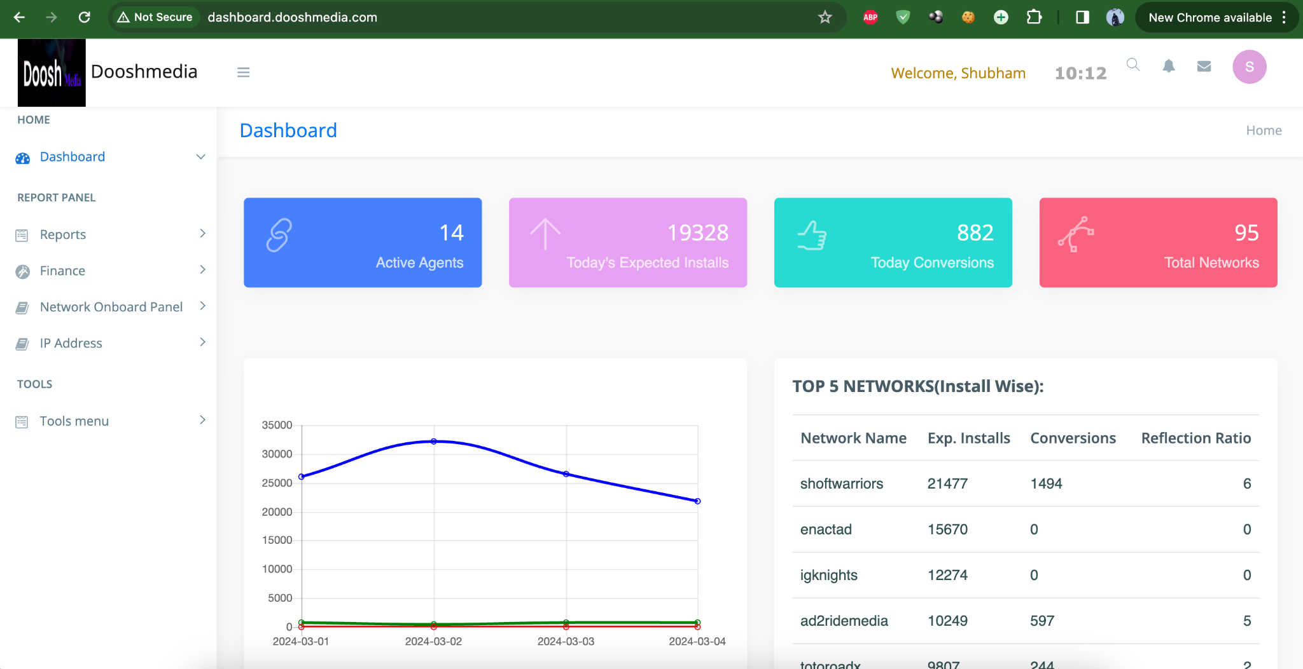
Few of the projects we have delivered.
Affiliate Marketing Dashboard Panel: Empowering Your Affiliate Program Management

Slide 5
DESCRIPTION:
Our dashboard offers a comprehensive overview of your affiliate marketing activities, providing insights and analytics to help you make informed decisions and drive success.
Key Features:
Real-time Performance Monitoring: Track affiliate performance and campaign metrics in real-time to gauge effectiveness and identify areas for improvement.
Customizable Reporting: Generate customizable reports tailored to your specific goals and requirements, allowing for in-depth analysis and strategic planning.
Publisher Management: Easily add, manage, and track multiple publishers simultaneously, ensuring seamless execution and maximum ROI.
Explicit Tools: Facilitate special tools for affiliates through built-in tools section like, Link Tester, API Integrator, etc.
Commission Tracking: Automate commission tracking and payout processes to streamline operations and ensure accuracy and transparency.

Slide 6
2. Maximizing Conversion Insights: The Power of Postback Tracking

Slide 7
DESCRIPTION:
A postback server is a critical component in affiliate marketing and advertising campaigns, enabling advertisers and publishers to track and optimize conversions effectively.
How we handle Millions of Clicks:
Scalable Infrastructure: Postback servers are typically hosted on robust infrastructure capable of handling high volumes of traffic.
Load Balancing: Load balancing techniques distribute incoming traffic across multiple servers to prevent overload and ensure optimal performance.
Caching Mechanisms: Utilizing caching mechanisms reduces the strain on the server by storing frequently accessed data, such as click information and session identifiers.
Asynchronous Processing: Implementing asynchronous processing techniques allows the server to handle multiple requests concurrently, improving efficiency and responsiveness.
Monitoring and Optimization: Constant monitoring of server performance and traffic patterns enables proactive optimization to accommodate increasing click volumes and maintain uptime.

Slide 8
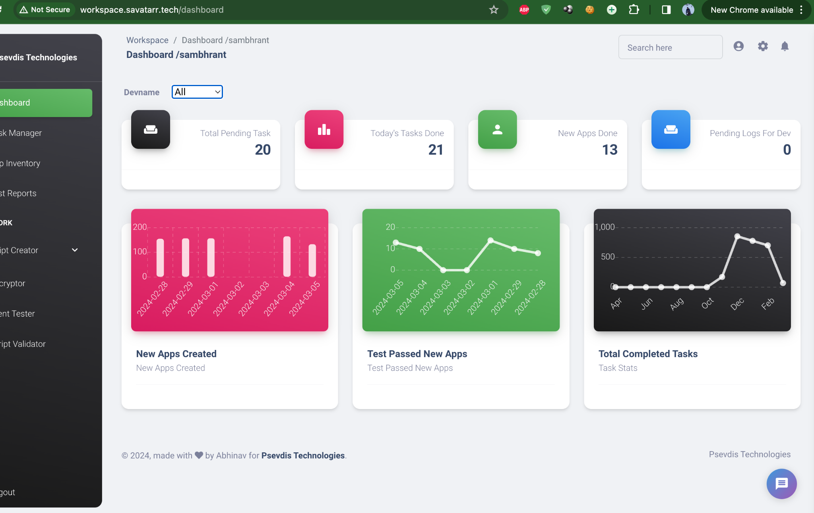
3. Efficiency Engine: Workforce & Tasks Management Dashboard

Slide 9
DESCRIPTION:
The Workforce & Tasks Management Dashboard is a comprehensive platform designed to streamline and optimize organizational workflows, track employee tasks, and generate insightful reports.
Key Features:
Task Tracking: Allows employees to view assigned tasks, update task status, and track progress in real-time.
Priority Management: Prioritizes tasks based on urgency and importance, ensuring that critical tasks are addressed promptly.
Collaboration Tools: Facilitates collaboration among team members through built-in communication features, i.e internal messaging mechanisms.
Data Security: Implements robust security measures to protect sensitive employee and organizational data, ensuring compliance with industry regulations and standards.
Explicit Tools: Facilitates with some of the commonly used testing tools required for the organisation as demanded.

Slide 10
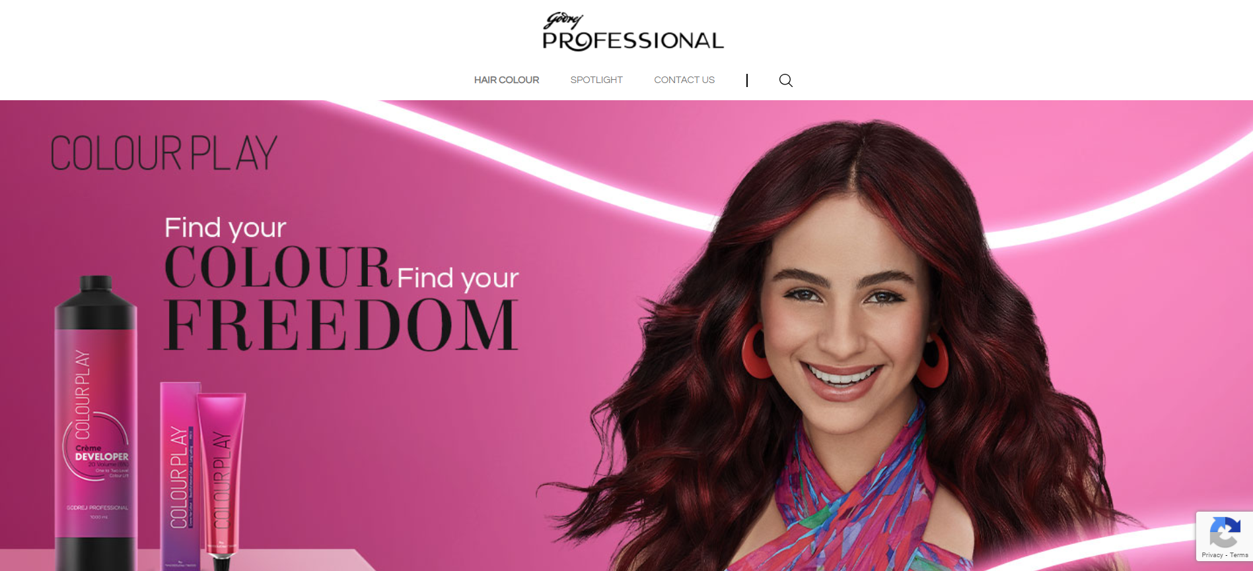
4. Godrej Professional

Slide 11
DESCRIPTION:
We at Savatarr have ensured that the Godrej Professional project is delivered on time, keeping in mind all the Industry standards are met aligned with the client, besides the development we also consulted them for security measures to be taken for the website.
Results and Impact
Key Achievements: We delivered the project in just 45 days despite hurdles like DDOS attacks on the server.
Metrics or Data: The project is Live and the client was really happy with the delivery.
Client Feedback: We received appreciation from the client for our fast delivery of the project.

Slide 12
Our Responsibilities :
Position: Project Management and Cyber Security Head
Key Responsibilities: We at Savatarr have ensured that the Godrej Professional project is delivered on time, keeping in mind all the Industry standards are met aligned with the client, besides the development we also consulted them for security measures to be taken for the website.
Technical Aspects :
Technologies Used: PHP Laravel, Open Admin, MySQL, Apache2 server on Microsoft Azure.
Challenges and Solutions: It was all good until we were on the development server, once we got live on Beta, our servers went under DDOS attack and thanks to our security experts we managed to migrate our servers to a previous snapshot and within 3 hours we were back live with a much more secure server infra.

Slide 13
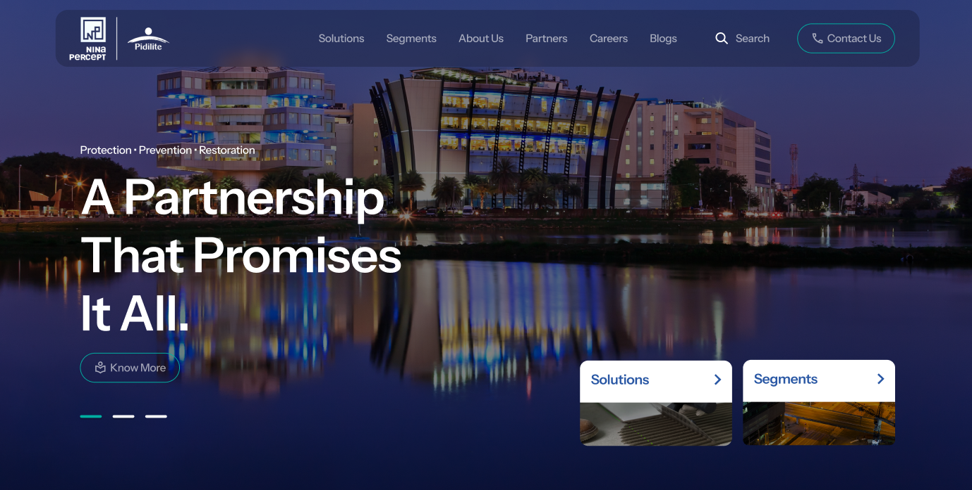
5. Pidilite Nina

Slide 14
DESCRIPTION:
We have worked on Pidilite Nina with custom WordPress, keeping in mind all the Industry standards are met aligned with the client, besides the development we also consulted them for security measures to be taken for the website.
Results and Impact
Key Achievements: We delivered the project in just 15 days.
Metrics or Data: The project is on Staging phase (Beta Live) and we are all set to go live by the end of this Month.

Slide 15
Few Campaigns we ran
Journey of Yappy
The billion dollar investment for yappy.
Just like any other short video platform Yappy from Russia was a little unsure about the potential of Affiliate Marketing, so they invested around $10,000 initially in the first month. Later when they found the results outstanding they raised the investment 10 times, i.e $1,00,000 per month. From 2Million downloads on playstore to 6 Million downloads in just 6 months, the investors were surprised and as a result they raised the funds even more.

Slide 16
Journey of Dream 11
There are 100s of mobile applications launching everyday in almost every genre but only few are smart enough to choose the right way of marketing.
With the integration of Affiliate Marketing, Dream11 witnessed a spike of 37% in conversion rates from referrals, when compared to other paid media sources.
On the registration front, the rate of users registering from referrals is now 28% higher than that from other media sources, while the first deposit rate has peaked beyond all other paid media sources.

Slide 17
The Rise of Jio Cinema in India: The Role of Affiliate Marketing
Jio Cinema’s rise in India has been fueled by strategic use of affiliate marketing alongside its diverse content and free streaming model.
Events like the IPL saw massive promotions via affiliates, driving user acquisition. By targeting niche audiences—such as regional language viewers and sports enthusiasts.
Jio Cinema showcased tailored content, boosting engagement. Cost-effective customer acquisition through performance-based campaigns and credible endorsements further solidified its position, affiliate marketing played a pivotal role in establishing Jio Cinema as a leading OTT platform.

Slide 18
TECH STACK EXPERTISE:
Native / Hybrid Apps
We have 3+ years of experienced Developers for Java / Kotlin.
For Android Apps we use Java/Kotlin and for ios development we use React Native.
MOBILE
Primary Technologies that we work for mobile app development.
We have delivered plenty of mobile apps based on React Native
Performance Centric
For projects which are hungry for speed and efficiency we use, Go-Lang, Java, Node JS and C++.
We have built robust APIs and web Apps with millions of clicks simultaneously on daily basis.
DESKTOP / WEB
Primary Technologies that we work for web/desktop app development.
Economic
For economic projects we use, Python & PHP.
Most of the applications are built in Python(Django/Flask) & Cake PHP in real world.

Slide 19
Few of our clients

Slide 20
Thank You
For your
Attention

Slide 21
Contact Us
Our Location
258-259 1st FLOOR, Block R, Uttam Nagar, New Delhi
www.savatarr.com
business@savatarr.com
raveesh@savatarr.tech
+91-9717327005

